Slide 1
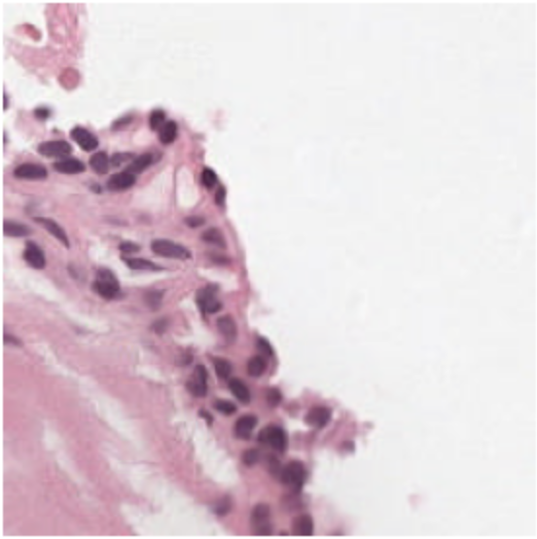
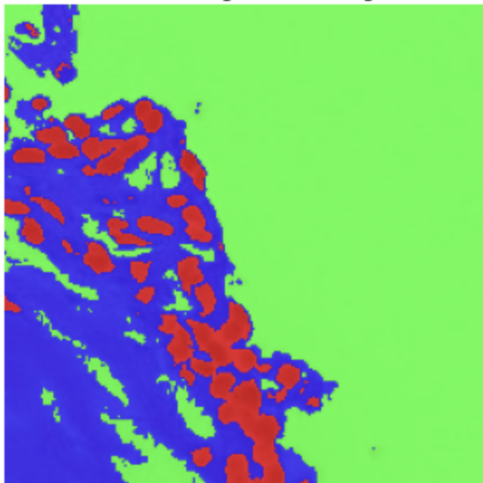
AI Campus Cedars
Team 6 Meeting (Tuesday, April 22): Semantic Segmentation of Prostate Cancer
Biopsy Tissue Using Deep Learning
PANDA (Prostate Cancer Grade Assessment) Challenge
Omar Lab
Department of Computational Biomedicine
Assistant Coaches: Okan Ozdemir and Rish Sharma
April 22, 2025
Semantic Segmentation

Slide 2
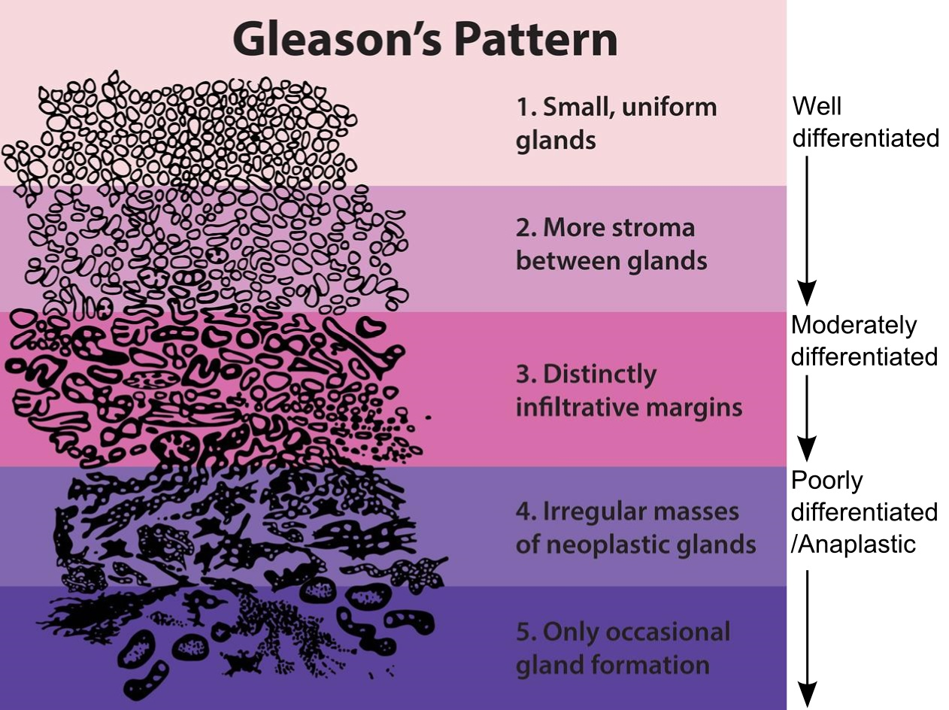
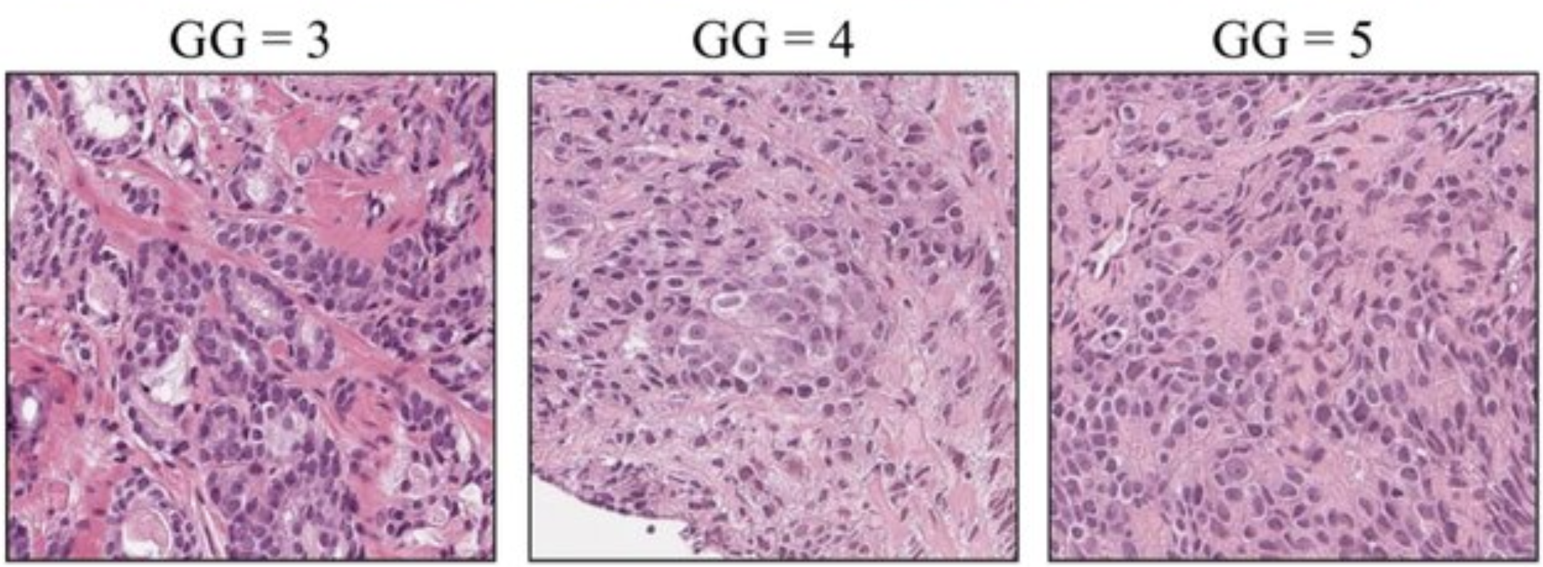
Prostate Cancer & Gleason Grading
The Gleason grading system is used to assess how aggressive the cancer is, based on glandular architecture seen in H&E-stained biopsy tissue. This grade influence treatment decisions: surveillance vs surgery/radiation.

Slide 3
Why Automate Tissue Segmentation?
Manual Gleason grading is time-consuming and subject to interobserver variability, especially between intermediate grades.
Automated segmentation into benign epithelium, stroma, and Gleason patterns will: a) standardize diagnosis, and b) enable large-scale analysis across thousands of cases

Slide 4
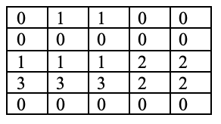
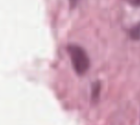
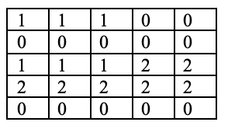
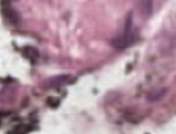
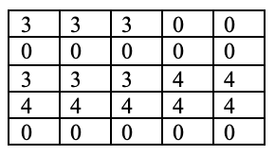
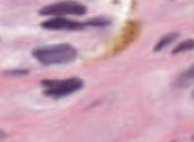
Dataset Overview (Image and Mask Pairs)
0: background (non-tissue) or unknown 1: stroma (connective tissue, non-epithelium tissue) 2: healthy (benign) epithelium 3: cancerous epithelium (Gleason 3) 4: cancerous epithelium (Gleason 4) 5: cancerous epithelium (Gleason 5)

Slide 5
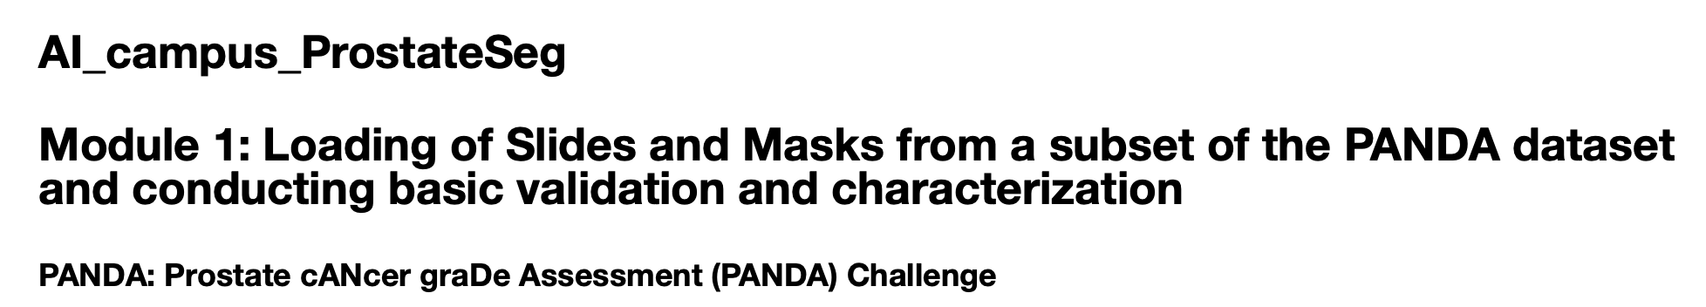
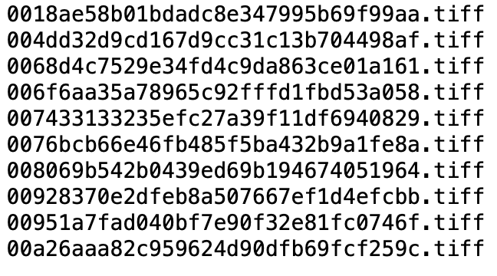
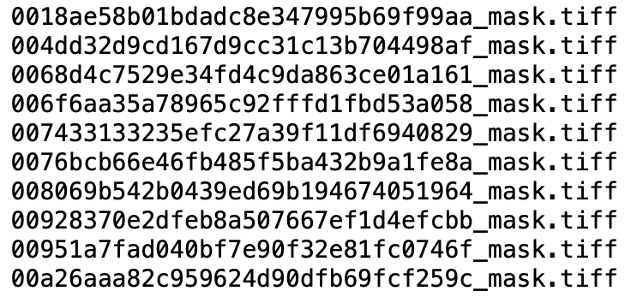
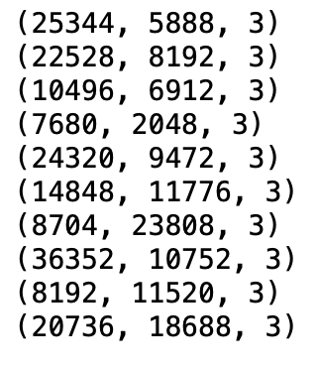
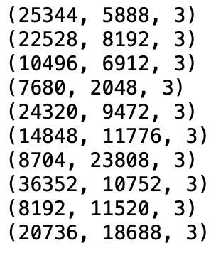
(Recap of Last Meetings) Module 1: Loading of Slide-Mask Pairs
Coupled image and mask files dataset
Matched dimensions

Slide 6
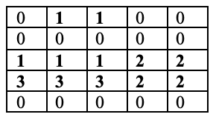

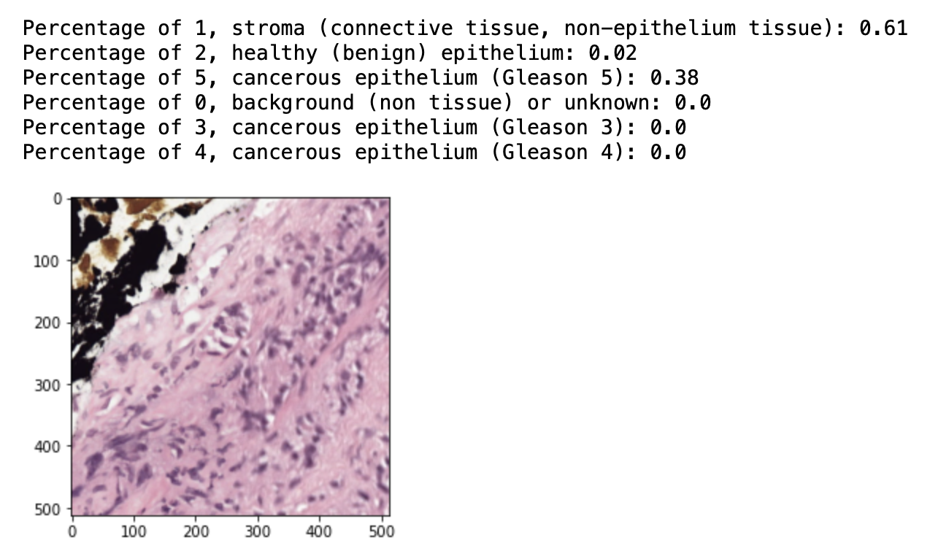
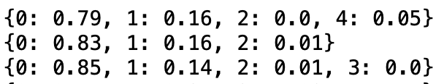
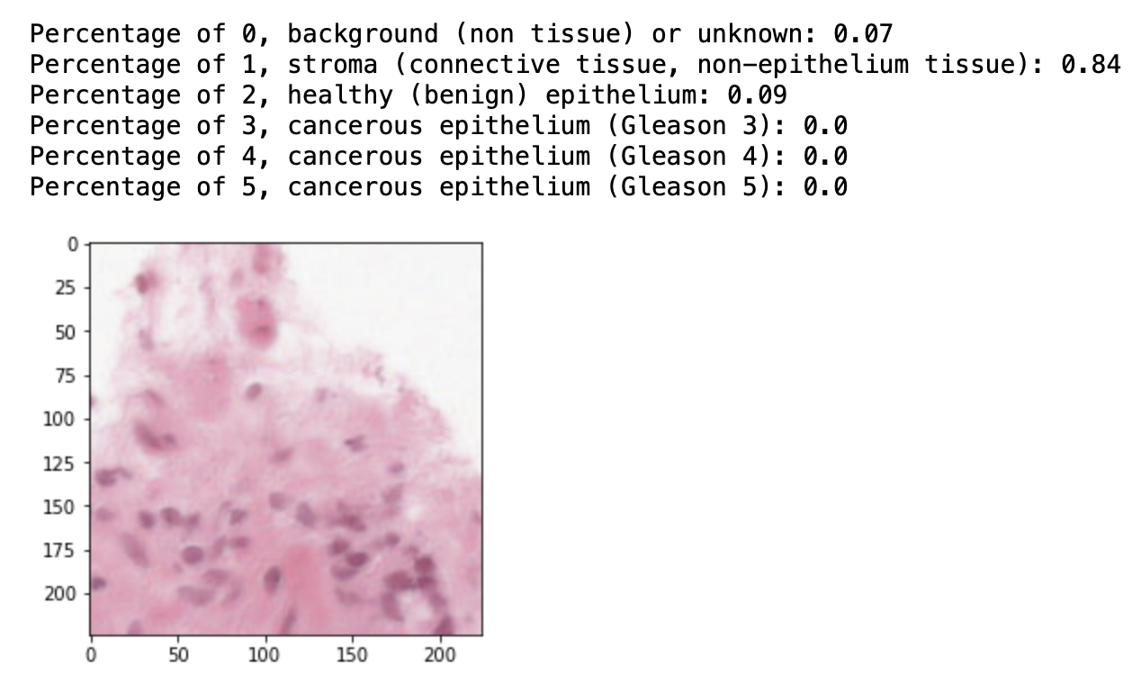
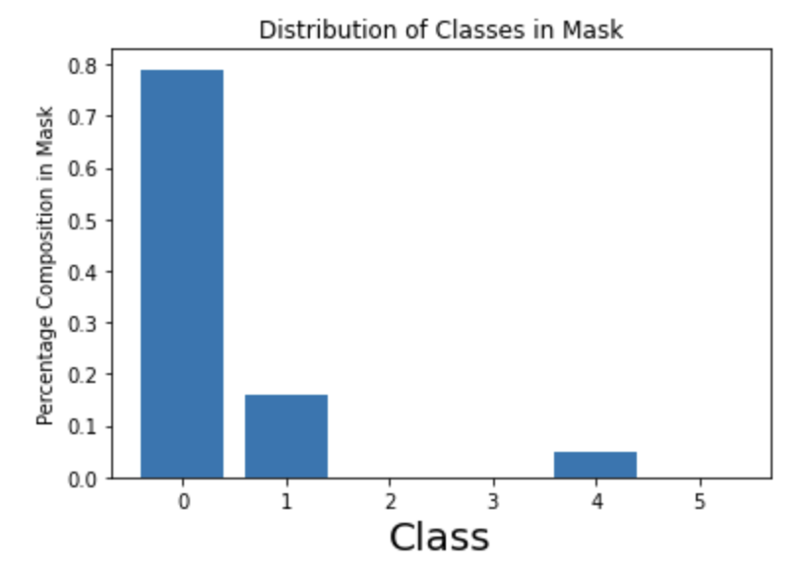
(Recap of Last Meetings) Module 2: Data Visualization and Exploratory Data Analysis
Summary of signal to background ratios in masks
Tile-wise plots by distribution of classes
Summary of class presence in masks
Summary of class distributions in masks

Slide 7
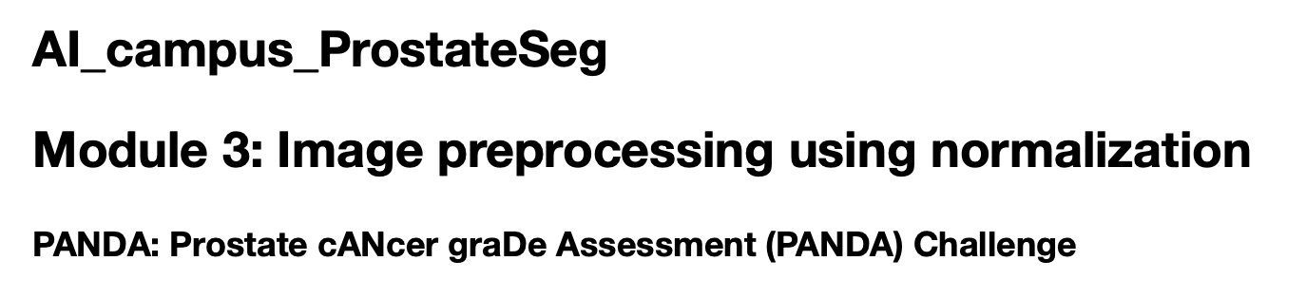
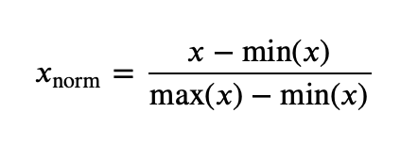
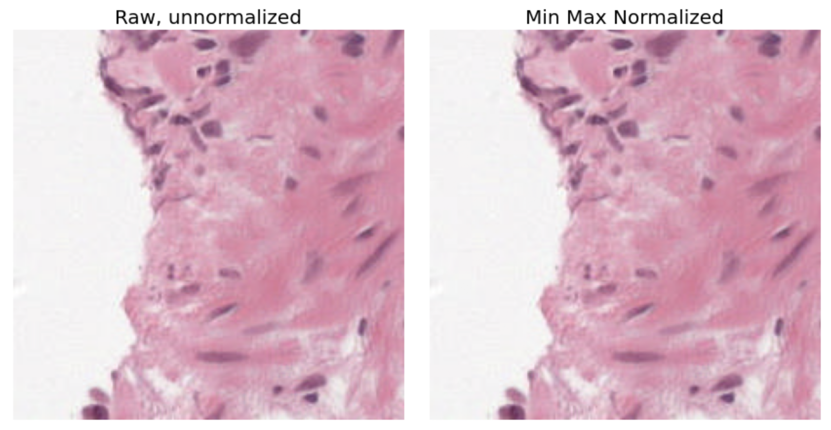
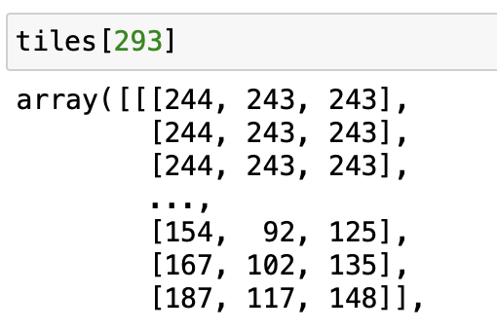
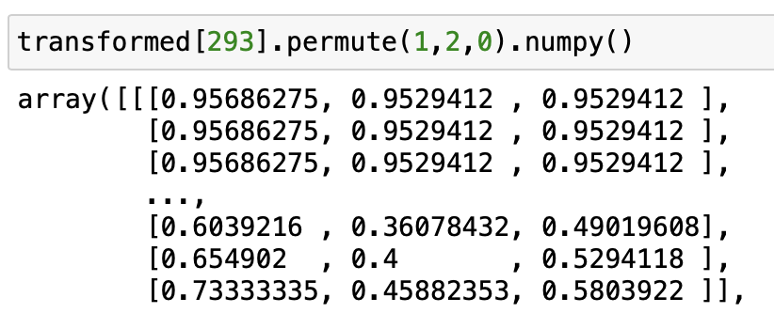
(Recap of Last Meetings) Module 3: Image Pre-Preprocessing Using Normalization
Min-max normalization
Channel-wise normalization

Slide 8
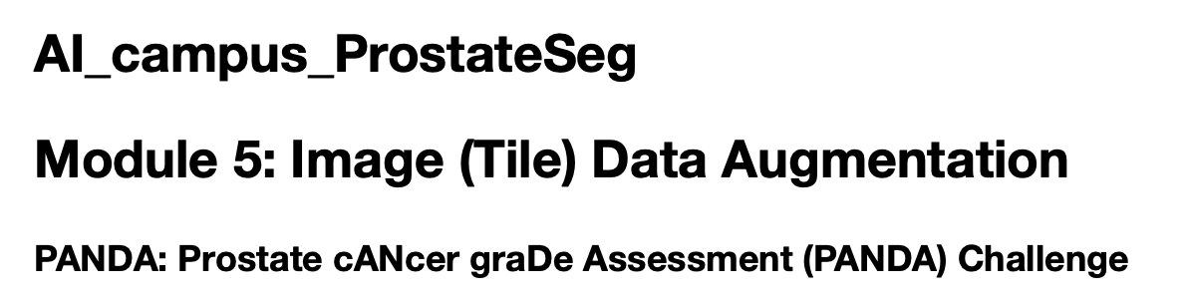
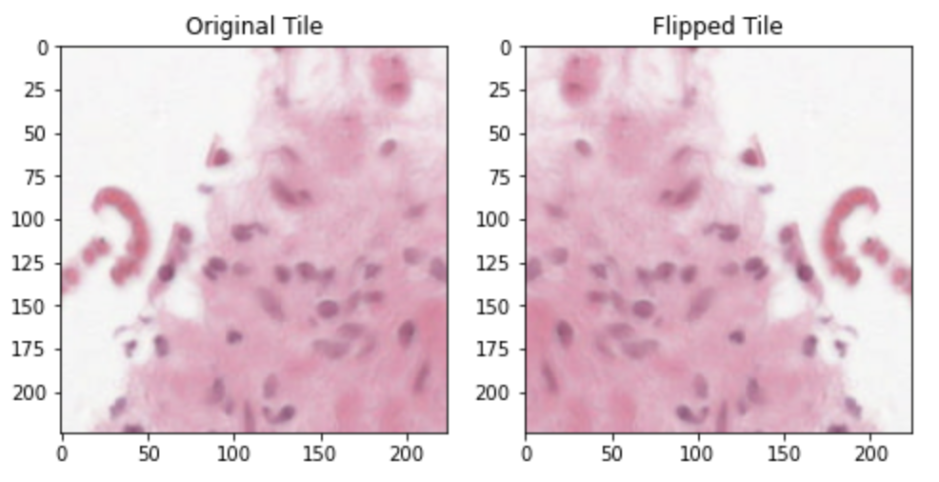
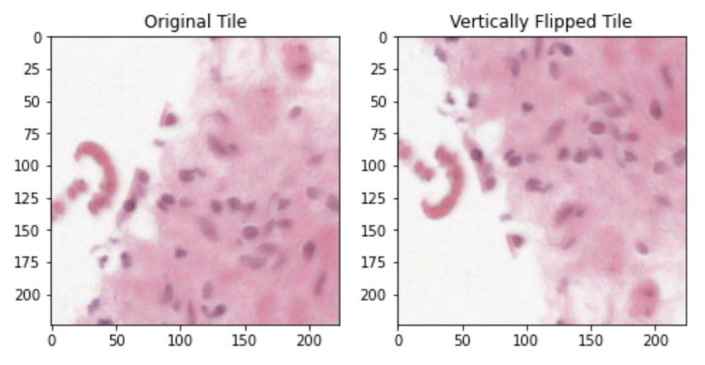
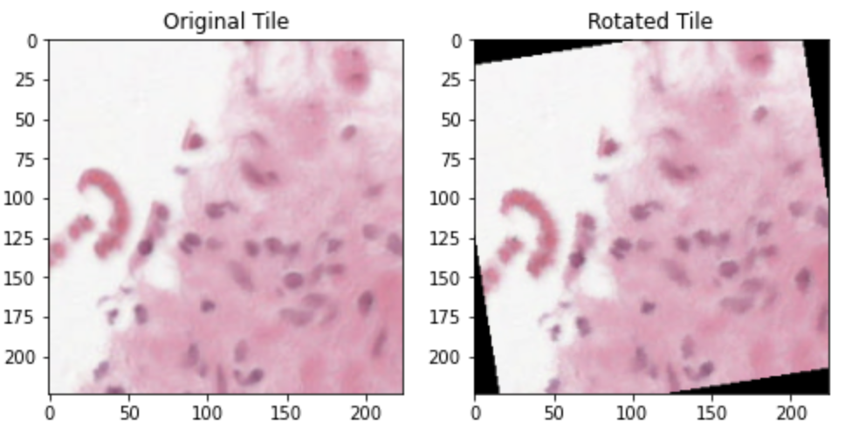
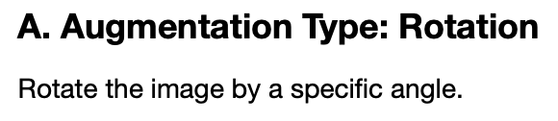
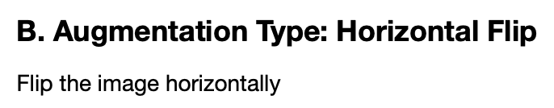
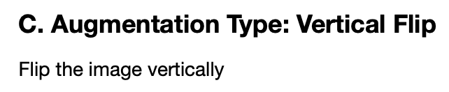
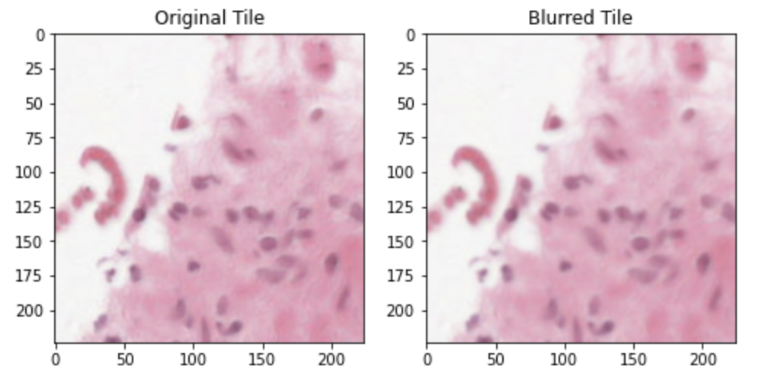
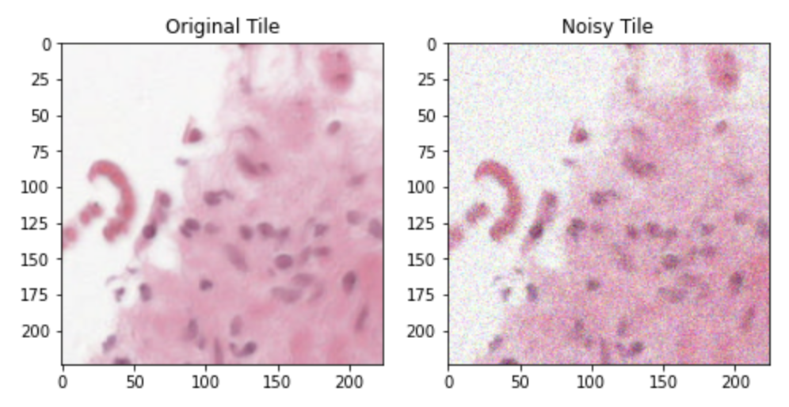
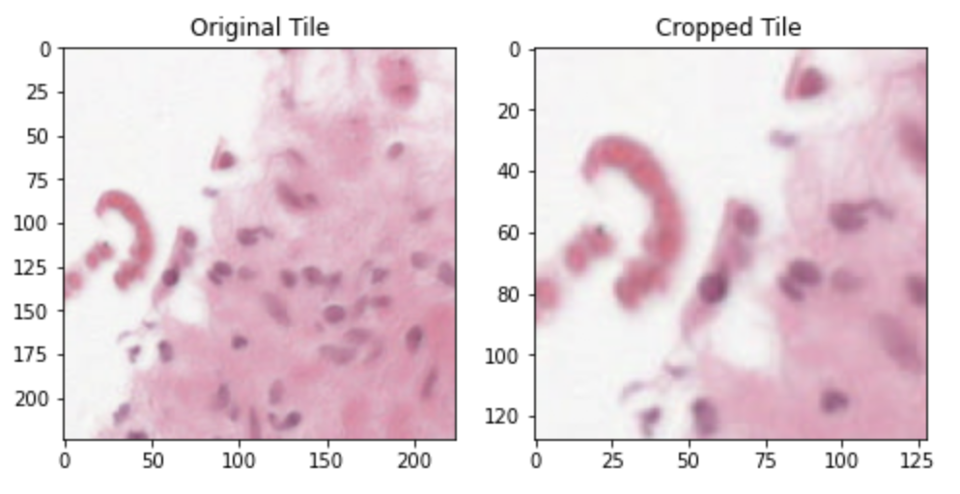
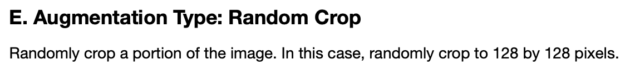

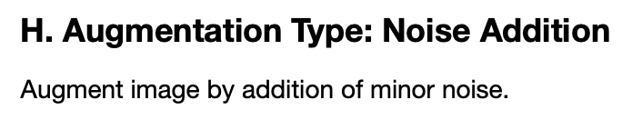
(Recap of Last Meetings) Module 5: Image (Tile) Data Augmentation

Slide 9
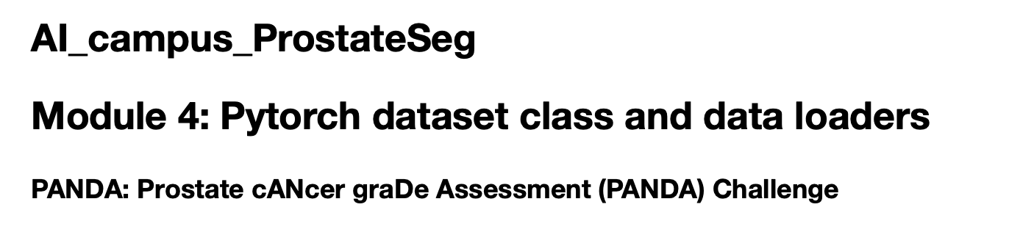
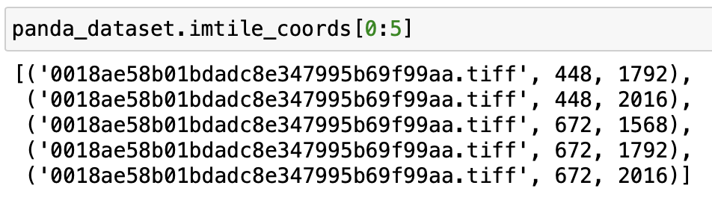
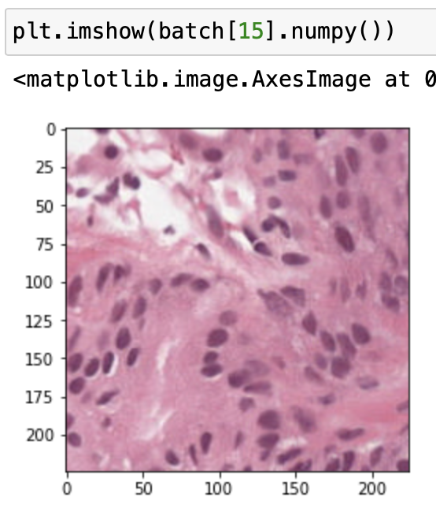
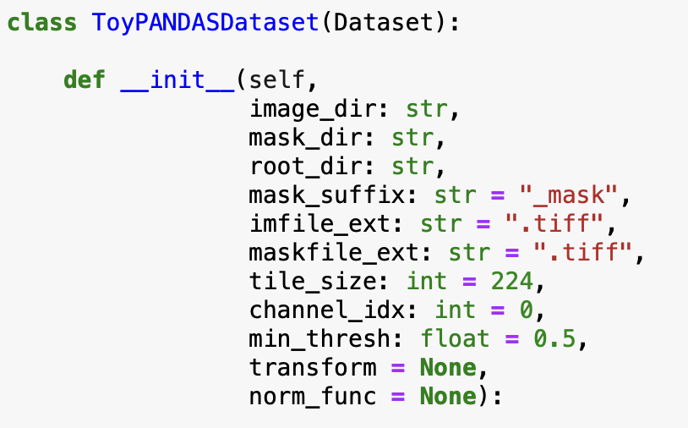
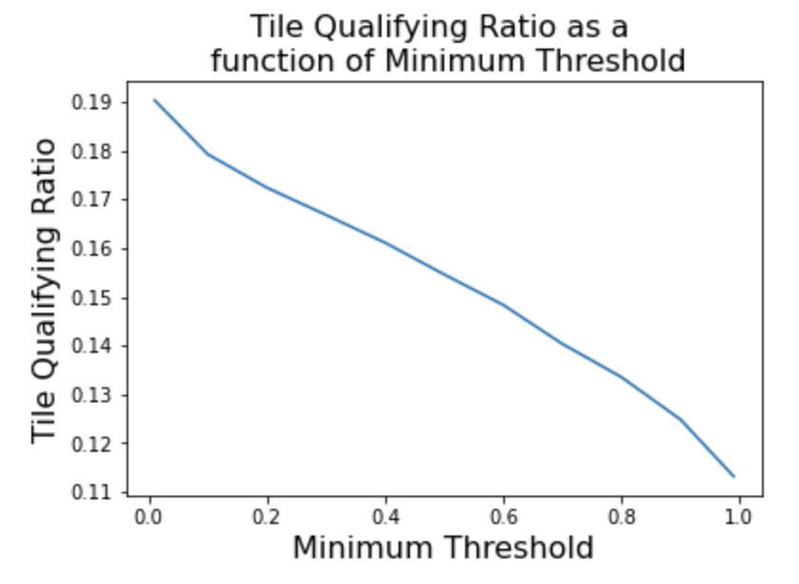
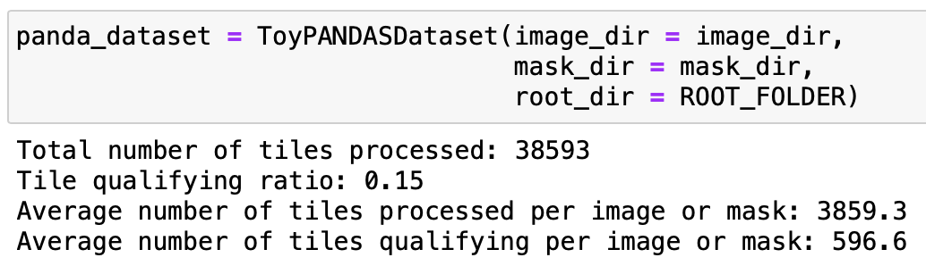
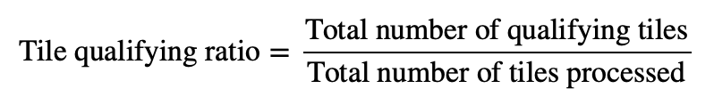
(Recap of Last Meetings) Module 4: PyTorch Dataset Class and Data Loaders
Dataset class iterates over image tiles, tuple contains image file and tile coordinates
Example tile
Custom dataset class
Tile-wise processing of PANDA dataset images

Slide 10

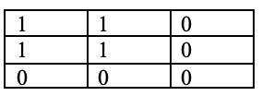
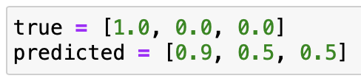

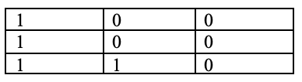
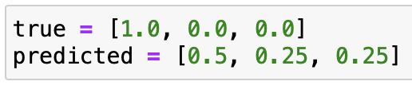

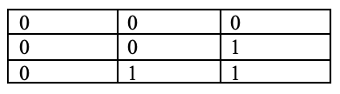
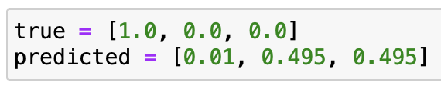




(Recap of Last Meetings) Module 6: Loss Function and Metrics for Semantic Segmentation
IOU=1.0
Ground truth mask
Predicted mask
IOU=0.33
Ground truth mask
Predicted mask
IOU=0.00
Ground truth mask
Predicted mask
Intersection over Union between ground truth and predicted mask pairs

Slide 11




(Agenda for Today’s Meeting) Module 7: Unsupervised Image Segmentation Using K-means clustering
K means algorithm
Unsupervised algorithm for grouping similar data points
Partitions data into K distinct clusters
Each cluster represented by its centroid (mean)
Assigns points based on distance to nearest centroid
Iteratively refines clusters until convergence
Pixel → 3D [R,G,B] vector
2-dimensional
Notes:
conda install -c conda-forge scikit-learn
pip install scipy
pip install opencv-python

Slide 12



(Agenda for Today’s Meeting) Module 8: Unsupervised Image Segmentation Using DBSCAN
Pixel → 3D [R,G,B] vector
Parameters in DBSCAN:
Eps - radius of the neighborhood around a data point.
MinPts - minimum number of points required within the eps radius to form a dense region
Core points have a sufficient number of neighbors within eps radius
Border points are near core points but lack enough neighbors to be core points
Noise points which do not belong to any cluster.
DBSCAN
K means
Objective – Partition all points into k groups that minimize distance to cluster centers
Forces every pixel into one of k clusters
DB Scan
Objective - Are there dense regions in this space separated by low-density gaps?
Tissue images often have smooth color variation - No clear “gaps” between colors
So DBSCAN could give one big connected region → merges everything
DBSCAN cannot “cut” this into clusters because: There’s no low-density boundary to separate them
K means
K-means imposes structure. DBSCAN requires structure.

